Slide 1
BINGO
Eng. Mohammed Arnaoty DR: Mohamed el Ramly
Course : Software Engineering Group : 3,4 IT Department

Slide 2
Team Members
Mahmoud Mohamed Gamal 20120363
Amr Abo El-Aila 20120256
Mahmoud Hamdy Sayed 20120352
Amr Sameh Raafat 20120260

Slide 3
Overview
Objective of the Project
The game will be played in a server-client fashion, where one device starts the game as a server. Other players send join requests to the server. The server can accept up to only 4 requests per game, that’s number of players can’t exceed 4.

Slide 4
Overview Cont’d
Requirements
Each player starts the game by setting his 25 numbers. As the game proceeds, each player choose a number from 1 to 25 and the system delete this number at other players’ devices . System delete a letter from bingo if the player got 5 deleted numbers in the same row or column or diagonal . The winner is the player who end the bingo word first.

Slide 5
Functional Requirement
Create server
Join server
Set the board
Starting the game
Get number
Update cell
Check row
Check column
Check diagonal
Update board
Check winner
Exchange turns
Show winner

Slide 6
Non Functional Requirement
Professional GUI

Slide 7
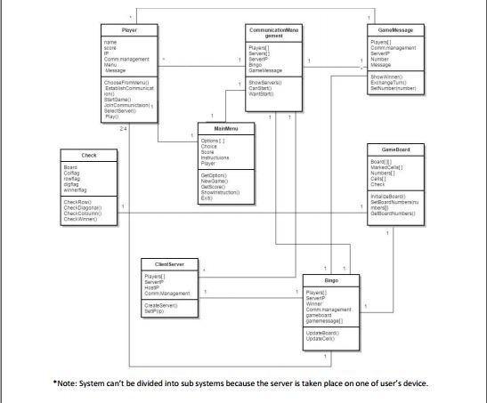
Overview Cont’d
Class Diagram

Slide 8
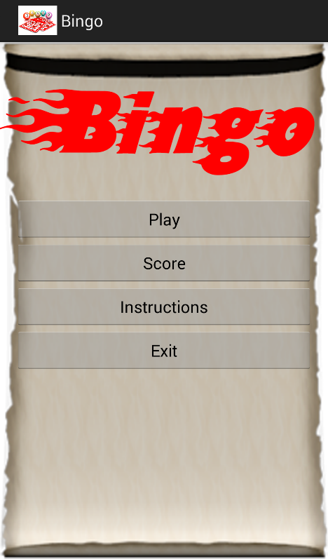
Demo
The Demo will be live

Slide 9
Challenges and Difficulties
miss understanding of project objectives
Time
Deliver the tasks on time

Slide 10
Lessons
Every thing at the beginning is difficult
Give everything its value and never give up
Learn how to develop an android application
How to use github

Slide 11
do better or different
Manage time
Make meetings more than this time

Slide 12


